Slide 1
Recursive binary search

Slide 2
Outline
In this lesson, we will:
Define an ordering on various types
Define when an array is sorted
Learn how to determine if an array is sorted
Learn how to determine if a sub-range of an array is sorted

Slide 3
Recursive algorithms
A recursive algorithm is one that:
Performs operations that simplify the problem
Call the same function on that simpler problem
Takes the result from the simpler problem to solve the larger problem

Slide 4
A recursive implementation
Suppose we want to perform a recursive binary search:
std::size_t binary_search_rec( double const array[],
std::size_t const begin,
std::size_t const end,
double const sought_value );
As before, we are searching the array from the index begin up to but not including the index end
From array[begin] to array[end - 1]

Slide 5
A recursive implementation
Here is a possible algorithm:
If begin == end, we are done, as the sub-array is empty
Return end to indicate the entry is not present
Otherwise, calculate the mid-point:
If the sought value is at the mid-point, return the mid-point
Otherwise, depending the relative values, determine what should be recursively called or what should be returned…

Slide 6
A recursive implementation
We can, however, have a simpler algorithm:
If begin == end, we are done, as the sub-array is empty
Return end to indicate the entry is not present
Otherwise, if the number of entries being searched is six or less, just perform a linear search
Otherwise, calculate the mid-point:
If the sought value is at the mid-point, return the mid-point
Otherwise, recursively call binary search on the appropriate sub-interval

Slide 7
A recursive implementation
Here is a recursive implementation:
std::size_t binary_search_rec( double const array[],
std::size_t const begin,
std::size_t const end,
double const sought_value ) {
if ( end - begin <= 6 ) {
return linear_search( array, begin, end, sought_value );
} else {
std::size_t midpoint{(begin + end)/2};
if ( array[midpoint] == sought_value ) {
return midpoint;
} else if ( array[location] > sought_value ) {
return binary_search_rec( array, begin, midpoint, sought_value );
} else {
return binary_search_rec( array, midpoint + 1, end, sought_value );
}
}
}

Slide 8
A recursive implementation
Output:
0: 5
1: 5
2: 0
3: 5
4: 5
5: 1
6: 2
7: 4
8: 5
9: 5
10: 10
11: 6
12: 10
13: 10
14: 9
15: 10
Let’s test our algorithm:
int main() {
int array[10]{2, 5, 6, 6, 7, 9, 11, 11, 11, 14};
for ( int k{0}; k < 16; ++k ) {
std::cout << k << ":\t"
<< binary_search_rec( array, 0, 10, k )
<< std::endl;
}
return 0;
}

Slide 9
A recursive implementation
Output:
0: 5
1: 5
2: 0
3: 5
4: 5
5: 1
6: 2
7: 4
8: 5
9: 5
10: 10
11: 6
12: 10
13: 10
14: 9
15: 10
Unfortunately, some answers are wrong:
int main() {
int array[10]{2, 5, 6, 6, 7, 9, 11, 11, 11, 14};
for ( int k{0}; k < 16; ++k ) {
std::cout << k << ":\t"
<< binary_search_rec( array, 0, 10, k )
<< std::endl;
}
return 0;
}
It does, however, find 9 at index 5

Slide 10
A recursive implementation
What is the problem when we search for 0?
0 | 1 | 2 | 3 | 4 | 5 | 6 | 7 | 8 | 9
2 | 5 | 6 | 6 | 7 | 9 | 11 | 11 | 11 | 14
if ( end - begin <= 6 ) {
return linear_search( array, begin, end, sought_value );
} else {
std::size_t midpoint{(begin + end)/2};
if ( array[midpoint] == sought_value ) {
return midpoint;
} else if ( array[location] > sought_value ) {
return binary_search_rec( array, begin, midpoint, sought_value );
} else {
return binary_search_rec( array, midpoint + 1, end, sought_value );
}
}

Slide 11
A recursive implementation
Here is a correct implementation:
std::size_t binary_search_rec( double const array[],
std::size_t const begin,
std::size_t const end,
double const sought_value ) {
if ( end - begin <= 6 ) {
return linear_search( array, begin, end, sought_value );
} else {
std::size_t midpoint{(begin + end)/2};
if ( array[midpoint] == sought_value ) {
return midpoint;
} else if ( array[location] > sought_value ) {
std::size_t result{binary_search_rec( array, begin, midpoint, sought_value )};
return ( result == midpoint ) ? end : result;
} else {
return binary_search_rec( array, midpoint + 1, end, sought_value );
}
}
}

Slide 12
Comparison
Question:
Which is easier to understand?
Which is easier to explain?
std::size_t binary_search( double const array[],
std::size_t const begin,
std::size_t const end,
double const sought_value ) {
std::size_t left{begin};
std::size_t right{end - 1};
while ( left != right ) {
std::size_t midpoint{(left + right)/2};
if ( array[midpoint] == sought_value ) {
return midpoint;
} else if ( array[midpoint] > sought_value ) {
if ( left == midpoint ) {
return capacity;
} else {
right = midpoint - 1;
}
} else {
if ( midpoint == right ) {
return capacity;
} else {
left = midpoint + 1;
}
}
}
return (array[left] == sought_value) ? left : capacity;
}
std::size_t binary_search_rec( double const array[],
std::size_t const begin,
std::size_t const end,
double const sought_value ) {
if ( end - begin <= 6 ) {
return linear_search( array, begin, end, sought_value );
} else {
std::size_t midpoint{(begin + end)/2};
if ( array[midpoint] == sought_value ) {
return midpoint;
} else if ( array[location] > sought_value ) {
std::size_t result{binary_search_rec( array, begin, midpoint, sought_value )};
return ( result == midpoint ) ? end : result;
} else {
return binary_search_rec( array, midpoint + 1, end, sought_value );
}
}
}

Slide 13
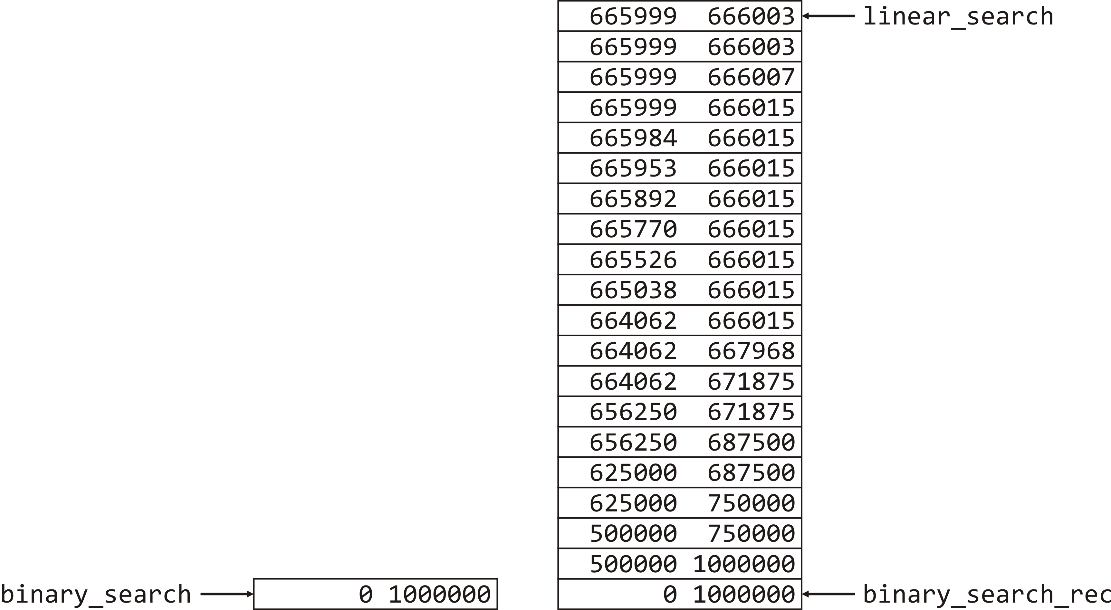
Comparison
If the recursive implementation is both easier to implement and explain, are there any drawbacks?
The first, we will call it the iterative implementation, only has one function call
If you are searching for a value in an array with a capacity of one million, each time you calculate a mid-point, you must make another function call
Here are the call stacks for one such search:

Slide 14
Summary
Following this lesson, you now
Have further understanding of recursion
Know how to implement a recursive binary search
Understand that while the implementation is simpler and perhaps more intuitive than the iterative implementation, there is an additional cost in terms of additional function calls

Slide 15
References
[1] Fredosaurus
http://www.fredosaurus.com/notes-cpp/algorithms/searching/rbinarysearch.html

Slide 16



Colophon
These slides were prepared using the Georgia typeface. Mathematical equations use Times New Roman, and source code is presented using Consolas.
The photographs of lilacs in bloom appearing on the title slide and accenting the top of each other slide were taken at the Royal Botanical Gardens on May 27, 2018 by Douglas Wilhelm Harder. Please see
https://www.rbg.ca/
for more information.

Slide 17
Disclaimer
These slides are provided for the ece 150 Fundamentals of Programming course taught at the University of Waterloo. The material in it reflects the authors’ best judgment in light of the information available to them at the time of preparation. Any reliance on these course slides by any party for any other purpose are the responsibility of such parties. The authors accept no responsibility for damages, if any, suffered by any party as a result of decisions made or actions based on these course slides for any other purpose than that for which it was intended.

